Slide 1
Multifunctional Robot
Kunal Nevrekar
Omkar Mahindrakar
Gayatri Joshi
PROJECT GUIDE – Prof. Shweta Ashtekar

Slide 2
Introduction
Reducing human efforts and enhancing their lifestyles.
The main motive behind building this robot is its application in medical field.
The hardware and software which is been used is definitely a user-friendly programmed that will connect through robot.
This multifunctional robot can be operated manually as well as automatically.

Slide 3
The design of the robot is kept simple so that it can be accessed by every individual with/without using a remote control.
On path obstacles can be detected using sensors that is mounted on the robot.
Video recording can also be done with the help of webcam.

Slide 4
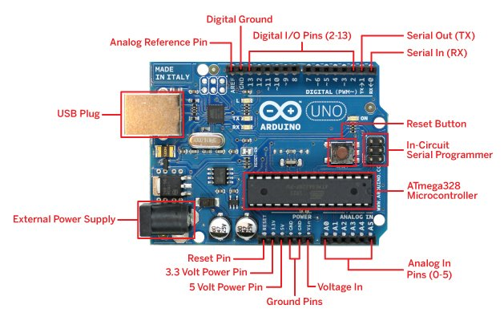
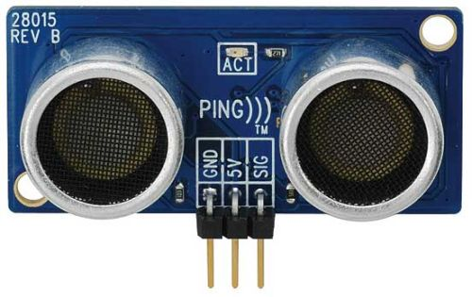
Hardware Used
Arduino UNO
Ultrasonic Sensor

Slide 5
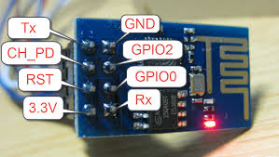
ESP8266
ESP8266 is an impressive, low cost WiFi module suitable for adding WiFi functionality to an existing microcontroller project via a UART serial connection.
The module can even be reprogrammed to act as a standalone WiFi connected device–just add power.
The feature list is impressive and includes:
802.11 b/g/n protocol
Wi-Fi Direct (P2P), soft-AP
Integrated TCP/IP protocol stack

Slide 6
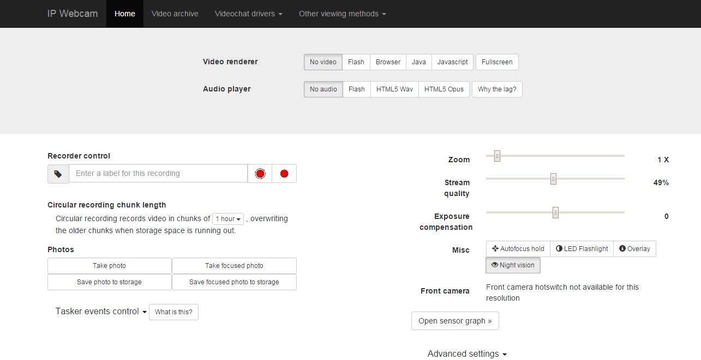
Software Used
IP Webcam Application
IP Webcam turns your phone into a network camera with multiple viewing options.
View your camera on any platform with VLC player or web browser.
Stream video inside WiFi network without internet access.
Optional Ivideon cloud broadcasting is supported for instant global access.

Slide 7
Block Diagram
IP Camera
Controlling PC
ESP8266
Ultrasonic Sensor
Arduino UNO
DC motor control
Servo motor

Slide 8
Servo motors are used to accomplish the purpose of continuous tracking of position which it would be receiving from ultrasonic sensors.
IPwebcam is used to deal with the video data from camera, and then send it via the Http protocol to the third party.
The third party such as mobile phone through wifi access routers, send control instructions in the TCP connection
After receiving instructions, Arduino can control the ESP8266, and then the shield would control motor, sensors, servos, and other electronic components.
Finally, the motor and steering gear will execute instructions

Slide 9
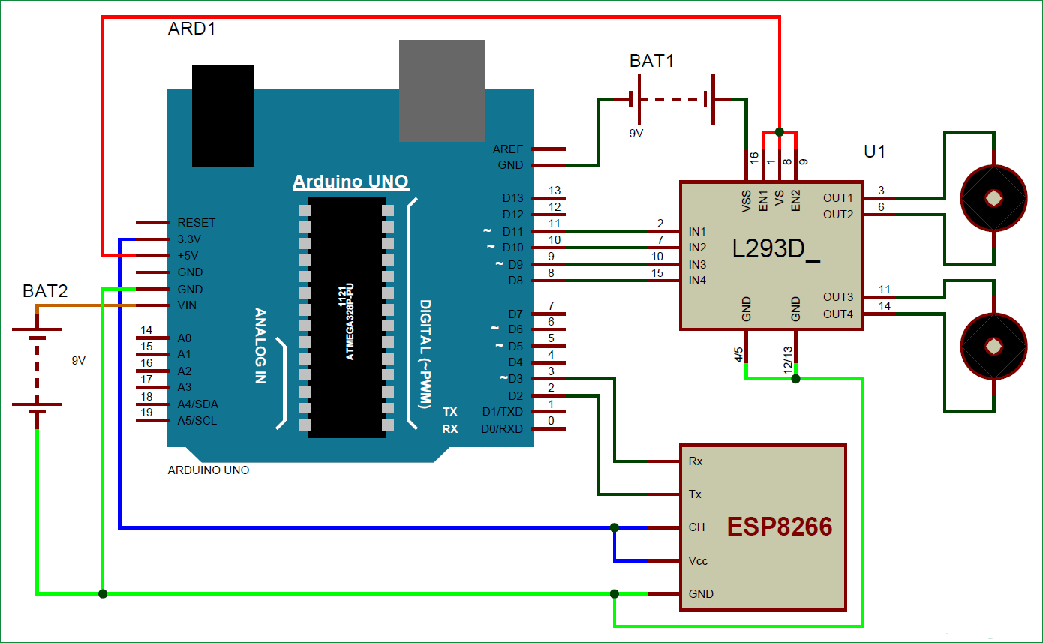
Circuit Diagram

Slide 10
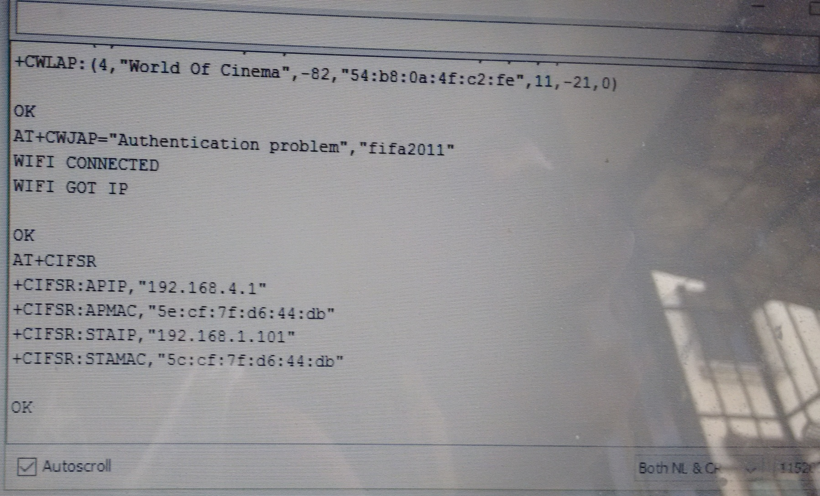
Result

Slide 11
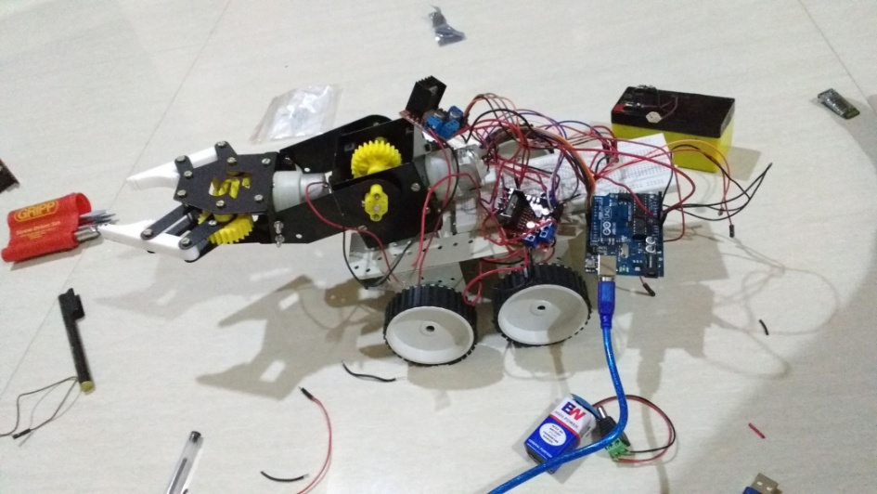
Conclusion
Multifunctional robots can be used in almost all mobile robot navigation systems.
They can also be used in dangerous environments, where human penetration could be fatal.
They can be used in mine detection by using metal detectors.
Also the camera used in the robot can help for tracking things, as well as for surveillance purposes.

Slide 12
THANK YOU

